Slide 1
Classes 3, 4
Tariffs and Quotas by
Alan V. Deardorff
University of Michigan
2020
PubPol/Econ 541

Slide 2
Pause for Discussion

Slide 3
  Questions from KOM
How do “specific” and “ad valorem” tariffs differ?
An import demand curve is sometimes called a “derived demand curve.” Why?
What is an “effective rate of protection”?

Slide 4
Outline
Tariff by Small country
Tariff by large country
Quotas
Recent tariff threats

Slide 5
Small country
Assumptions throughout
  Markets perfectly competitive
  Product homogeneous
  There are no “distortions” (externalities, etc.)
  Supply and demand curves linear
    Just for simplicity
  Model is partial equilibrium
  Model is static

Slide 6
Small country
Special assumption for small country case
  World price is given (country too small to influence it)
  More correctly: country’s supply and demand in that industry too small to influence the world price

Slide 7
Small country, Import Industry
P
Effects of move from autarky to free trade
  Price falls
  Quantity supplied falls
  Quantity demanded rises
  Imports rise
Welfare effects:
  Suppliers lose −a
  Demanders gain +(a+b)
  Country gains +b
S
P_{aut}
a
b
P₀=P_{W}
D
S₀
D₀
Q
M₀
Free trade

Slide 8
Small country tariff
P
Effects of a tariff, starting from free trade
  Price rises
  Quantity supplied rises
  Quantity demanded falls
  Quantity of imports falls
  Tariff revenue rises from zero
S
P_{aut}
P₁=P_{W}+t
t
P₀=P_{W}
D
M₁
S₀
S₁
D₁
D₀
Q
M₀
Specific Tariff t

Slide 9
Small country tariff
P
Welfare effects of a tariff, starting from free trade
  Suppliers gain +a
  Demanders Lose −(a+b+c+d)
  Government gains +c
  Country loses −(b+d)
S
WHY?
WHY?
P_{aut}
P₁=P_{W}+t
t
a
c
b
d
P₀=P_{W}
D
“Dead Weight Loss” =
M₁
S₀
S₁
D₁
D₀
Q
M₀
Specific Tariff t

Slide 10
Small country tariff
P
Welfare effects of a tariff, starting from free trade
  Suppliers gain +a
  Demanders Lose −(a+b+c+d)
  Government gains +c
  Country loses −(b+d)
S
P_{aut}
P₁=P_{W}+t
t
a
c
b
d
P₀=P_{W}
D
“Dead Weight Loss” =
M₁
S₀
S₁
D₁
D₀
Q
M₀
Specific Tariff t

Slide 11
Pause for Discussion

Slide 12
  Questions on Graph
If a price falls, why does the gain to demanders not equal the fall in what they pay? Is it larger than this or smaller?
If a price rises, why is the gain to suppliers not their rise in revenue? Is it larger or smaller?
In what sense does a small country gain by eliminating a tariff? Does anybody in the country lose?

Slide 13
Small country, larger tariff
P
Effects of doubling the tariff
  Price rises by twice as much
  Imports fall by twice as much
  Deadweight loss is 4-times as large!
    (Efficiency loss rises with the square of the tariff)
S
P_{aut}
P₂=P_{W}+2t
P₁=P_{W}+t
P₁=P_{W}+t
t
P₀=P_{W}
M₂
D
M₁
S₀
S₁
D₁
D₀
Q
M₀
Specific Tariffs, t, then 2t

Slide 14
Small country, prohibitive tariff
NOTE: You’ll have to calculate this from supply and demand
P
Welfare effects of a prohibitive tariff, starting from free trade
  Suppliers gain +a
  Demanders Lose −(a+b+d)
  Government gains 0
  Country loses −(b+d)
P_{W}+t_{P} ≠ P₁
S
P₁=
P_{aut}
t_{P}
a
b
d
P₀=P_{W}
D
“Dead Weight Loss” =
S₀
S₁
D₁
D₀
Q
M₀
( M₁=0 )
Specific Tariff t_{P} > P_{aut} − P_{W}

Slide 15
Comparative Statics with Tariff
Fall in World Price
P
S
P_{aut}
P₀=P_{W}+t
t
Tariff causes same dead-weight loss (with linear S&D)
P₁=P’_{W}+t
P_{W}
t
P’_{W}
D
M₁
S₁
S₀
D₀
D₁
Q
M₀

Slide 16
Comparative Statics with Tariff
Fall in World Price
P
Welfare effects of a fall in world price in presence of specific tariff
  Suppliers lose –a
  Demanders gain +(a+b+c+d)
  Government gains +(e+f)
  Country gains +(b+c+d+e+f)
S
P_{aut}
P₀=P_{W}+t
t
a
b
c
d
P₁=P’_{W}+t
P_{W}
t
e
f
P’_{W}
D
M₁
S₁
S₀
D₀
D₁
Q
M₀

Slide 17
Pause for
Your Questions

Slide 18
Pause for Discussion

Slide 19
  Questions on Tariff Analysis
Why does Lahart say the measurement of harm from tariffs is an “imperfect science”?
Lahart cited an estimate of loss from Trump’s tariffs and retaliation of 1.3% of GDP. Is this big?
What effects of tariffs are missing from the welfare effects of tariffs?

Slide 20
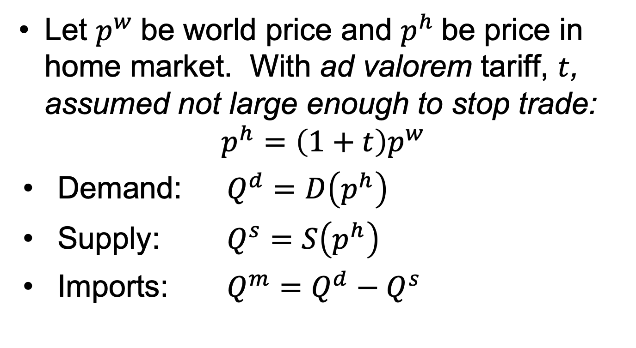
Small Country in Equations
Let $p^{w}$be world price and $p^{h}$be price in home market. With ad valorem tariff, $t$, assumed not large enough to stop trade:
$$p^{h}=\left(1+t\right)p^{w}$$
Demand: $Q^{d}=D\left(p^{h}\right)$
Supply: $Q^{s}=S\left(p^{h}\right)$
Imports: $Q^{m}=Q^{d}−Q^{s}$

Slide 21
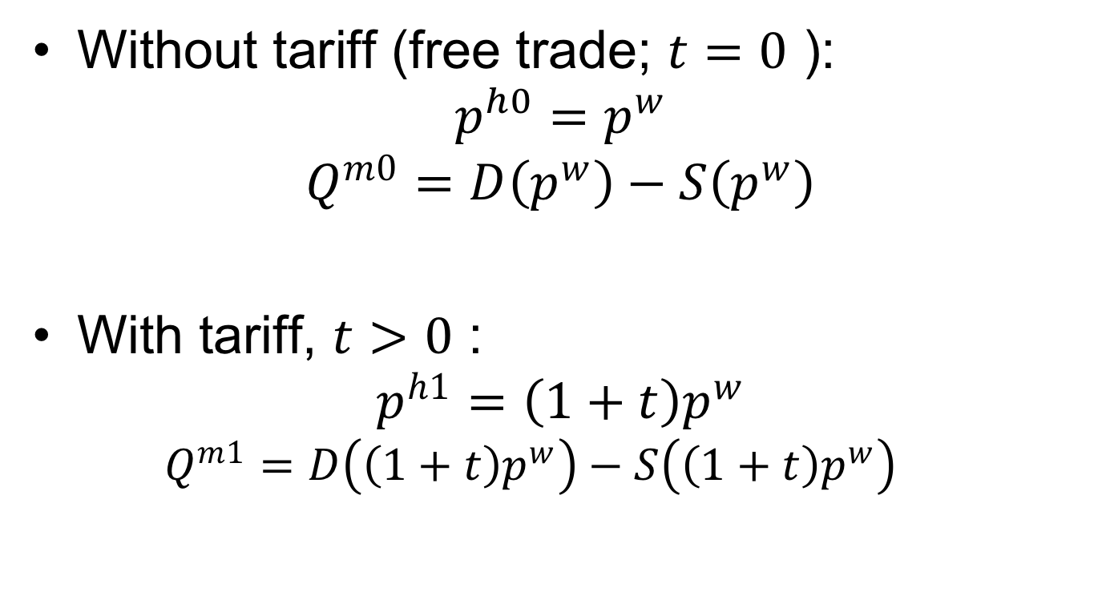
Small Country in Equations
Without tariff (free trade; $t=0$ ):
$$p^{h0}=p^{w}$$
$$Q^{m0}=D\left(p^{w}\right)−S\left(p^{w}\right)$$
With tariff, $t>0$ :
$$p^{h1}=\left(1+t\right)p^{w}$$
  $$Q^{m1}=D\left(\left(1+t\right)p^{w}\right)−S\left(\left(1+t\right)p^{w}\right)$$

Slide 22
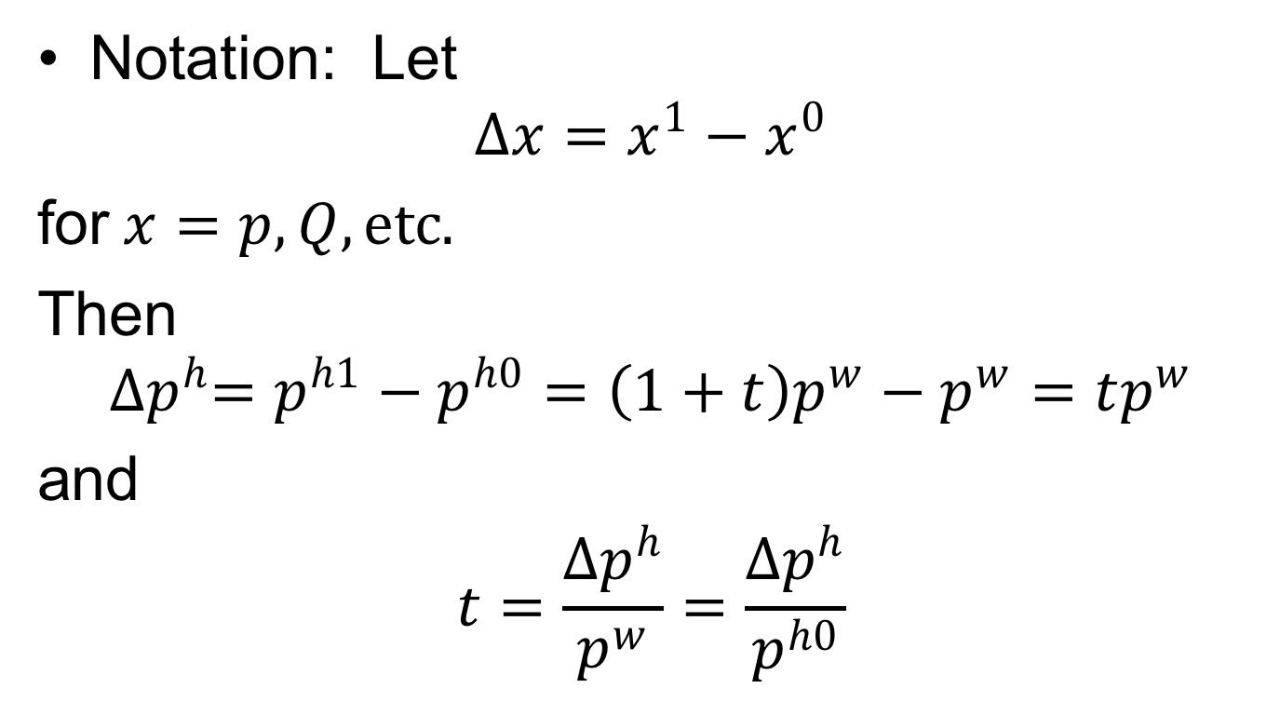
Small Country in Equations
Notation: Let
$$∆x=x^{1}−x^{0}$$
for$x=p, Q, etc.$
Then
$${∆p}^{h}=p^{h1}−p^{h0}=\left(1+t\right)p^{w}−p^{w}=tp^{w}$$
and
$$t=\frac{{∆p}^{h}}{p^{w}}=\frac{{∆p}^{h}}{p^{h0}}$$

Slide 23
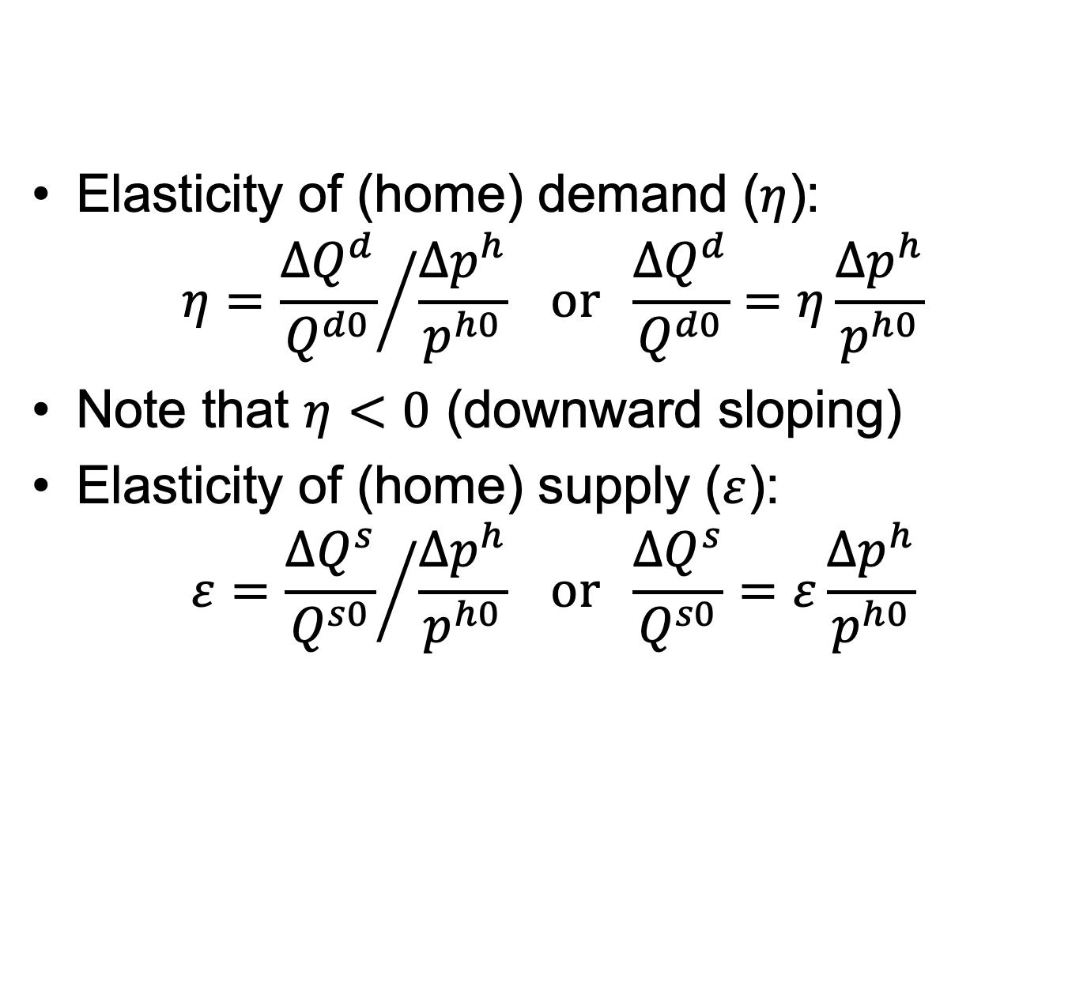
Small Country in Equations
Elasticity of (home) demand ($η$):
$$η={\frac{{∆Q}^{d}}{Q^{d0}}}/{\frac{{∆p}^{h}}{p^{h0}}} or \frac{{∆Q}^{d}}{Q^{d0}}=η\frac{{∆p}^{h}}{p^{h0}}$$
Note that $η<0$ (downward sloping)
Elasticity of (home) supply ($ε$):
$$ε={\frac{{∆Q}^{s}}{Q^{s0}}}/{\frac{{∆p}^{h}}{p^{h0}}} or \frac{{∆Q}^{s}}{Q^{s0}}=ε\frac{{∆p}^{h}}{p^{h0}}$$

Slide 24
Small Country in Equations
Notes regarding elasticities:
  They are defined here as changes relative to the free-trade quantities and prices.
  Different, but just as valid, would be changes relative to quantities and prices in the presence of the tariff.
  Answers will differ, but by much less than our uncertainty about the values of elasticities.
  In your calculations, use whichever is most convenient, but be consistent.

Slide 25
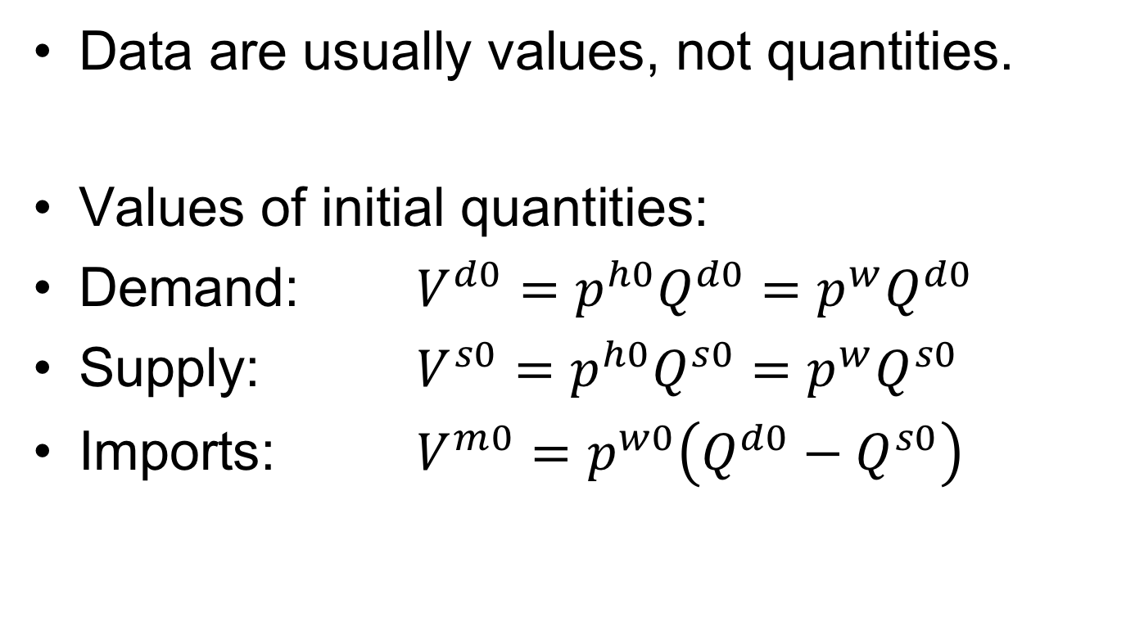
Small Country in Equations
Data are usually values, not quantities.
Values of initial quantities:
Demand: $V^{d0}=p^{h0}Q^{d0}=p^{w}Q^{d0}$
Supply: $V^{s0}=p^{h0}Q^{s0}=p^{w}Q^{s0}$
Imports: $V^{m0}=p^{w0}\left({Q^{d0}−Q}^{s0}\right)$

Slide 26
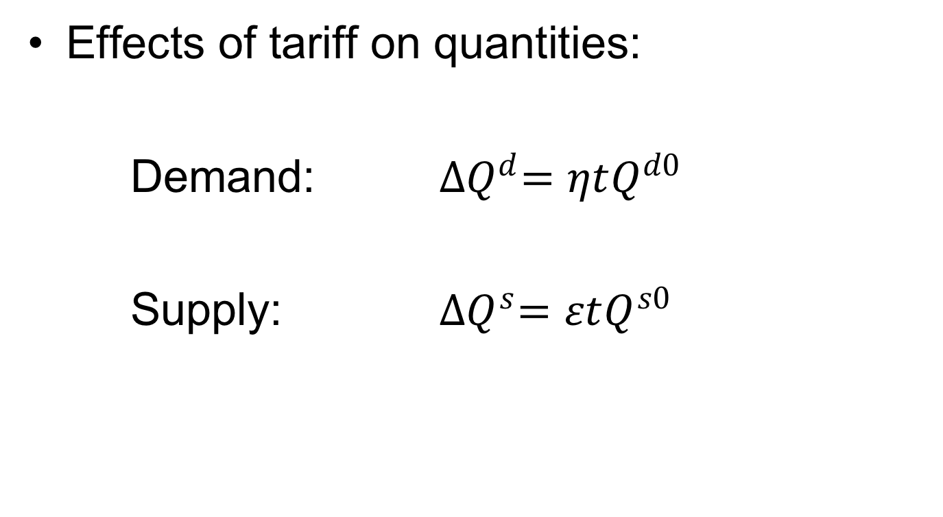
Small Country in Equations
Effects of tariff on quantities:
Demand: ${∆Q}^{d}=ηtQ^{d0}$
Supply: ${∆Q}^{s}=εtQ^{s0}$

Slide 27
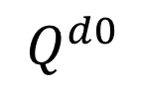
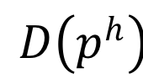
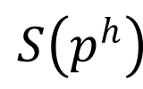
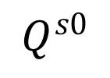
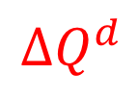
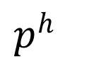

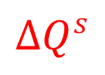
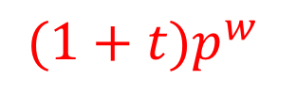


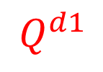

$p^{h}$
$$S\left(p^{h}\right)$$
${(1+t)p}^{w}$
e
$${∆p}^{h}={tp}^{w}$$
a
c
b
d
$p^{w}$
$$D\left(p^{h}\right)$$
$${∆Q}^{s}$$
$${∆Q}^{d}$$
$$Q^{s0}$$
$$Q^{s1}$$
$$Q^{d1}$$
$$Q^{d0}$$
$$Q$$
I’ll use $〈a〉$, $〈abcd〉, etc.$to represent these areas.

Slide 28





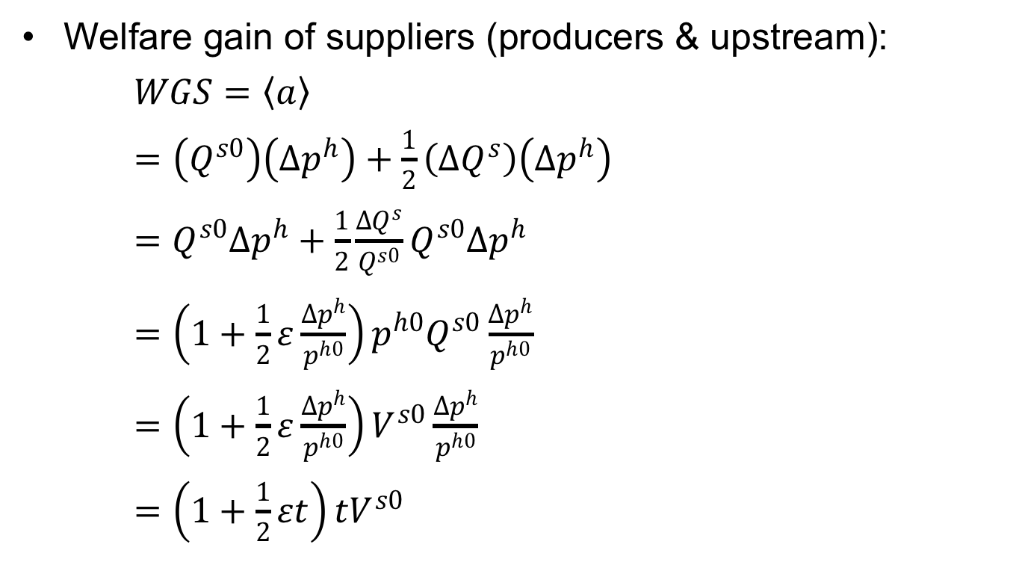








Small Country in Equations
Welfare gain of suppliers (producers & upstream):
$WGS=〈a〉$
$=\left(Q^{s0}\right)\left({∆p}^{h}\right)+\frac{1}{2}\left({∆Q}^{s}\right)\left({∆p}^{h}\right)$
$=Q^{s0}{∆p}^{h}+\frac{1}{2}\frac{{∆Q}^{s}}{Q^{s0}}Q^{s0}{∆p}^{h}$
$={\left(1+\frac{1}{2}ε\frac{{∆p}^{h}}{p^{h0}}\right)p^{h0}Q}^{s0}\frac{{∆p}^{h}}{p^{h0}}$
$=\left(1+\frac{1}{2}ε\frac{{∆p}^{h}}{p^{h0}}\right)V^{s0}\frac{{∆p}^{h}}{p^{h0}}$
$=\left(1+\frac{1}{2}εt\right){tV}^{s0}$
$p^{h}$
$$S\left(p^{h}\right)$$
${(1+t)p}^{w}$
$${∆p}^{h}={tp}^{w}$$
a
c
e
b
d
$p^{w}$
$$D\left(p^{h}\right)$$
$${∆Q}^{s}$$
$${∆Q}^{d}$$
$$Q^{s0}$$
$$Q^{s1}$$
$$Q^{d1}$$
$$Q^{d0}$$
$$Q$$

Slide 29
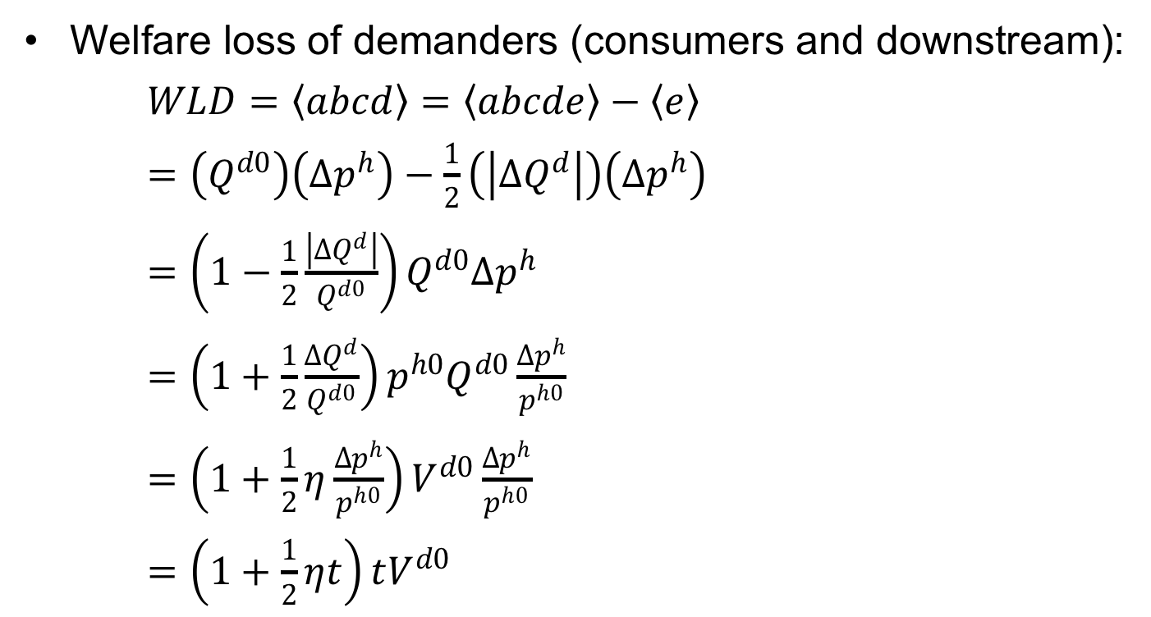
Small Country in Equations
Welfare loss of demanders (consumers and downstream):
$WLD=〈abcd〉=〈abcde〉−〈e〉$
$=\left(Q^{d0}\right)\left({∆p}^{h}\right)−\frac{1}{2}\left(\left|{∆Q}^{d}\right|\right)\left({∆p}^{h}\right)$
$=\left(1−\frac{1}{2}\frac{\left|{∆Q}^{d}\right|}{Q^{d0}}\right)Q^{d0}{∆p}^{h}$
$=\left(1+\frac{1}{2}\frac{{∆Q}^{d}}{Q^{d0}}\right){p^{h0}Q}^{d0}\frac{{∆p}^{h}}{p^{h0}}$
$=\left(1+\frac{1}{2}η\frac{{∆p}^{h}}{p^{h0}}\right)V^{d0}\frac{{∆p}^{h}}{p^{h0}}$
$=\left(1+\frac{1}{2}ηt\right)tV^{d0}$
$p^{h}$
$$S\left(p^{h}\right)$$
${(1+t)p}^{w}$
$${∆p}^{h}={tp}^{w}$$
a
c
e
b
d
$p^{w}$
$$D\left(p^{h}\right)$$
$${∆Q}^{s}$$
$${∆Q}^{d}$$
$$Q^{s0}$$
$$Q^{s1}$$
$$Q^{d1}$$
$$Q^{d0}$$
$$Q$$

Slide 30
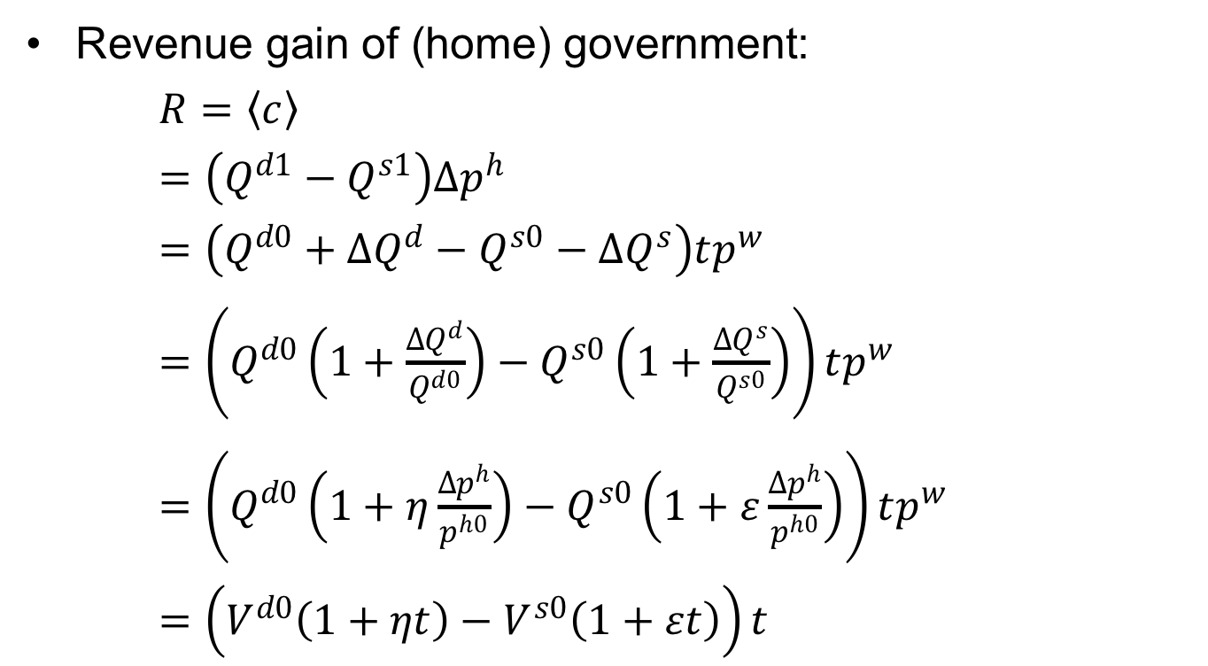
Small Country in Equations
$p^{h}$
$$S\left(p^{h}\right)$$
Revenue gain of (home) government:
$R=〈c〉$
$=\left(Q^{d1}−Q^{s1}\right){∆p}^{h}$
$=\left(Q^{d0}+{∆Q}^{d}−Q^{s0}−{∆Q}^{s}\right)tp^{w}$
$=\left(Q^{d0}\left(1+\frac{{∆Q}^{d}}{Q^{d0}}\right)−Q^{s0}\left(1+\frac{{∆Q}^{s}}{Q^{s0}}\right)\right)tp^{w}$
$=\left(Q^{d0}\left(1+η\frac{{∆p}^{h}}{p^{h0}}\right)−Q^{s0}\left(1+ε\frac{{∆p}^{h}}{p^{h0}}\right)\right)tp^{w}$
$=\left(V^{d0}\left(1+ηt\right)−V^{s0}\left(1+εt\right)\right)t$
${(1+t)p}^{w}$
$${∆p}^{h}={tp}^{w}$$
a
c
e
b
d
$p^{w}$
$$D\left(p^{h}\right)$$
$${∆Q}^{s}$$
$${∆Q}^{d}$$
$$Q^{s0}$$
$$Q^{s1}$$
$$Q^{d1}$$
$$Q^{d0}$$
$$Q$$

Slide 31



Small Country in Equations
$p^{h}$
$$S\left(p^{h}\right)$$
Welfare change for country:
$WCC=−〈abcd〉+〈a〉+〈c〉$
$=WLD−WGS−R$
$$=−\left(1+\frac{1}{2}ηt\right)tV^{d0}+\left(1+\frac{1}{2}εt\right){tV}^{s0}+\left(V^{d0}\left(1+ηt\right)−V^{s0}\left(1+εt\right)\right)t$$
${(1+t)p}^{w}$
$${∆p}^{h}={tp}^{w}$$
a
c
e
b
d
$p^{w}$
$$D\left(p^{h}\right)$$
$${∆Q}^{s}$$
$${∆Q}^{d}$$
$$Q^{s0}$$
$$Q^{s1}$$
$$Q^{d1}$$
$$Q^{d0}$$
$$Q$$
$=−tV^{d0}+{tV}^{s0}−\frac{1}{2}ηt^{2}V^{d0}+\frac{1}{2}εt^{2}V^{s0}+{tV}^{d0}−tV^{s0}$
$$+ηt^{2}V^{d0}−{εt}^{2}V^{s0}$$
$$=−\left[\frac{1}{2}εt^{2}V^{s0}−\frac{1}{2}ηt^{2}V^{d0}\right]$$

Slide 32
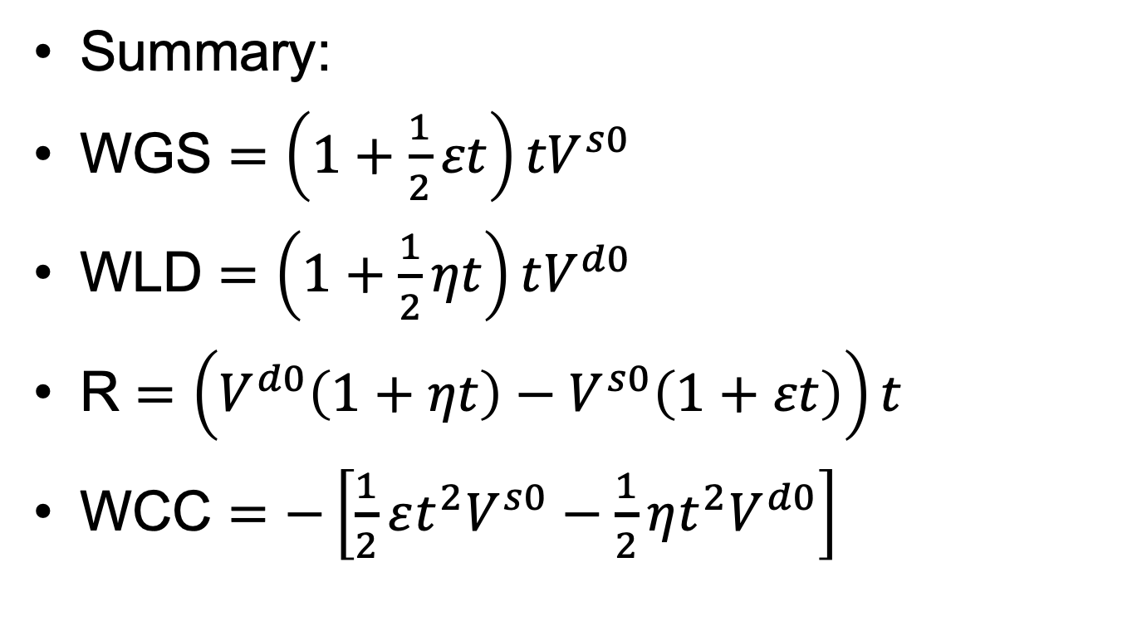
Small Country in Equations
Summary:
WGS $=\left(1+\frac{1}{2}εt\right){tV}^{s0}$
WLD $=\left(1+\frac{1}{2}ηt\right)tV^{d0}$
R $=\left(V^{d0}\left(1+ηt\right)−V^{s0}\left(1+εt\right)\right)t$
WCC $=−\left[\frac{1}{2}εt^{2}V^{s0}−\frac{1}{2}ηt^{2}V^{d0}\right]$

Slide 33
Pause for Discussion

Slide 34
  Questions on Equations
What information do you need to calculate these welfare effects?
How do they change with larger tariffs?
Explain the sources of the “production distortion loss” and the “consumption distortion loss.”
  Why does each occur, and who is it that loses in each case?
  Where do these appear in the equations?

Slide 35
Outline
Small country
Large country

Slide 36
Large country
(i.e., Two Countries)
Home
Foreign (*)
P
P*
S
S*
P_{aut}
D*
D
P*_{aut}
Q
Q*
Autarky

Slide 37
Large country
(i.e., Two Countries)
Home
World
Foreign
P
P
P*
S
XS*
S*
P_{aut}
D*
P_{W0}
P*₀=P_{W0}
P₀=P_{W0}
D
P*_{aut}
MD
S₀
D₀
Q
M₀=X*₀
M,X*
D*₀
S*₀
Q*
M₀
X*₀
Free trade

Slide 38
Large country
(i.e., Two Countries)
Home
World
Foreign
P
P
P*
S
XS*
S*
P₁
D*
P₁
P₀=P_{W0}
t
P*₁
P*₁
D
M₁=X*₁
MD
M₁
X*₁
S₀
D₀
Q
M₀=X*₀
M,X*
D*₀
S*₀
Q*
M₀
X*₀
S₁
D₁
D*₁
S*₁
Specific Tariff, t, by Home
Requires: P=P*+t, MD=XS*

Slide 39
Large country (i.e., Two Countries)
Home
World
Foreign
P
P
P*
S
XS*
S*
P₁
D*
P₁
t
a
c
t
c
P₀=P_{W0}
b
d
f
e
g
i
j
P*₁
e
h
e
P*₁
P*₁
D
MD
S₀
D₀
Q
M₀=X*₀
M,X*
D*₀
S*₀
Q*
S₁
D₁
D*₁
S*₁
Welfare effects of Tariff, t:
Foreign
  Suppliers −(h+i+e+j)
  Demanders +h
  Country −(i+e+j) = −(e+g)
Home
  Suppliers +a
  Demanders –(a+b+c+d)
  Government +(c+e)
  Country +e−(b+d) = e−f
  World: −(f+g) = −(b+d+i+j)

Slide 40
Large country, World Market
Welfare effects of a large-country tariff, starting from free trade
Home:
  Private sector (S&D) loses −(a+b)
  Government gains +(a+c)
  Country may gain or lose: +c−b
Foreign
  Private sector (S&D) loses −(c+d)
World loses −(b+d)
World Market
Home is Importer
Foreign (*) is Exporter
P
XS*
P₁
a
b
t
c
d
P*₁
MD
M₁=X*₁
M₀=X*₀
M,X*
“Dead Weight Loss” =

Slide 41
Large country, World Market
Thus large country will gain from tariff if c>b
What is area c?
  The portion of the tariff paid by foreign exporters, who get a lower price
  A transfer from foreign producers to the home government
  The result of improving the home country’s “terms of trade”
World Market
Home is Importer
Foreign (*) is Exporter
P
XS*
P₁
a
b
t
c
d
P*₁
MD
M₁=X*₁
M₀=X*₀
M,X*

Slide 42
Pause for Discussion

Slide 43
  Questions on Large Country
The figure for the world market shows the tariff causing the world price to fall. What in the figure tells you that the Home country is large?
In what sense might a large country gain by using a tariff? Who in the country benefits from that gain?
What reasons are there, if any, for a large country not to levy a tariff?

Slide 44
Large country, “Optimal” tariff
Watch as t rises
Welfare
P
P_{aut}
b
XS*
c
P₁
t
b
P*₁
c
t
MD
P_{aut}*
M₁=X*₁
M₀=X*₀
M,X*
P_{aut}–P_{aut}*

Slide 45
Large country, “Optimal” tariff
Watch as t rises
Welfare
P
P_{aut}
b
XS*
c
P₁
a
b
t
c
d
t
P*₁
MD
P_{aut}*
M₁=X*₁
M₀=X*₀
M,X*
P_{aut}–P_{aut}*

Slide 46
Welfare
P
P_{aut}
b
XS*
c
P₁
t
b
c
t_{opt}
t
P*₁
MD
P_{aut}*
c–b
M₁=X*₁
M₀=X*₀
M,X*
P_{aut}–P_{aut}*

Slide 47
How Sizes and Slopes Matter
Home
World
Foreign
P
P
P*
S
XS*
S*
P_{aut}
D*
P_{W0}
P*₀=P_{W0}
P₀=P_{W0}
D
P*_{aut}
MD
S₀
D₀
Q
M₀=X*₀
M,X*
D*₀
S*₀
Q*
M₀
X*₀
Free trade
Tariff

Slide 48
How Slopes Matter
Home
World
Foreign
P
P
P*
S
P_{aut}
XS*
S*
D*
P_{W0}
P*₀=P_{W0}
P₀=P_{W0}
D
P*_{aut}
MD
S₀
D₀
Q
M₀=X*₀
M,X*
D*₀
S*₀
Q*
M₀
X*₀
Free trade
Tariff

Slide 49
How Sizes Matter
Home
World
Foreign
P
P
P*
S
XS*
D*
S*
P_{aut}
P₀=P_{W0}
P*₀=P_{W0}
P_{W0}
P*_{aut}
D
MD
S₀
D₀
Q
M,X*
D*₀
S*₀
Q*
M₀
M₀=X*₀
X*₀
Free trade
Tariff

Slide 50
Pause for Questions

Slide 51
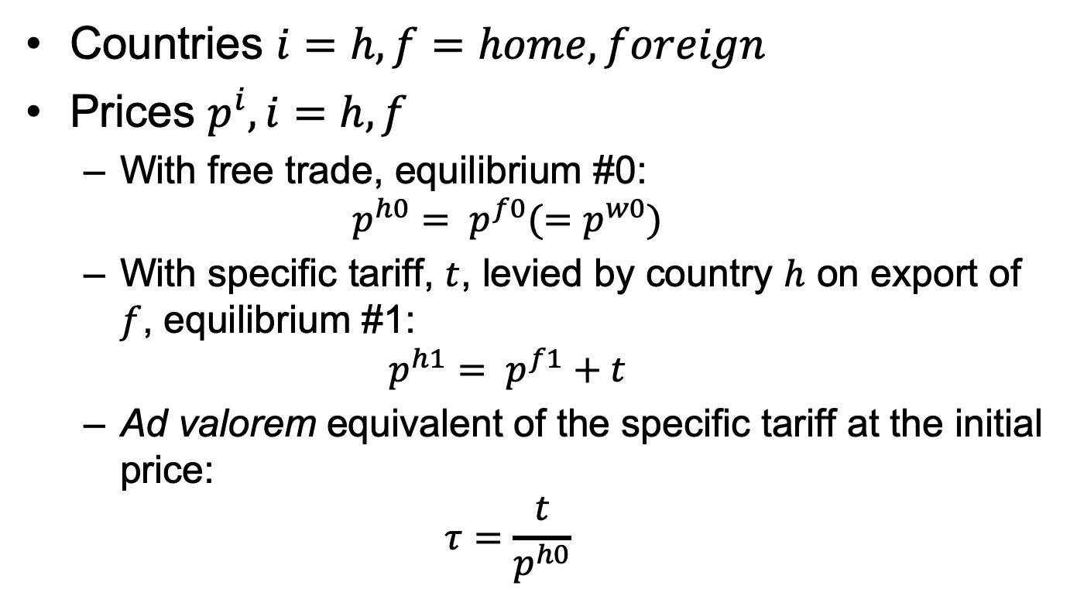
Two-Country in Equations
Countries $i=h, f=home, foreign$
Prices $p^{i}, i=h, f$
  With free trade, equilibrium #0:
  $$p^{h0}= p^{f0}(=p^{w0})$$
  With specific tariff, $t$, levied by country $h$ on export of $f$, equilibrium #1:
  $$p^{h1}= p^{f1}+t$$
  Ad valorem equivalent of the specific tariff at the initial price:
  $$τ=\frac{t}{p^{h0}}$$

Slide 52
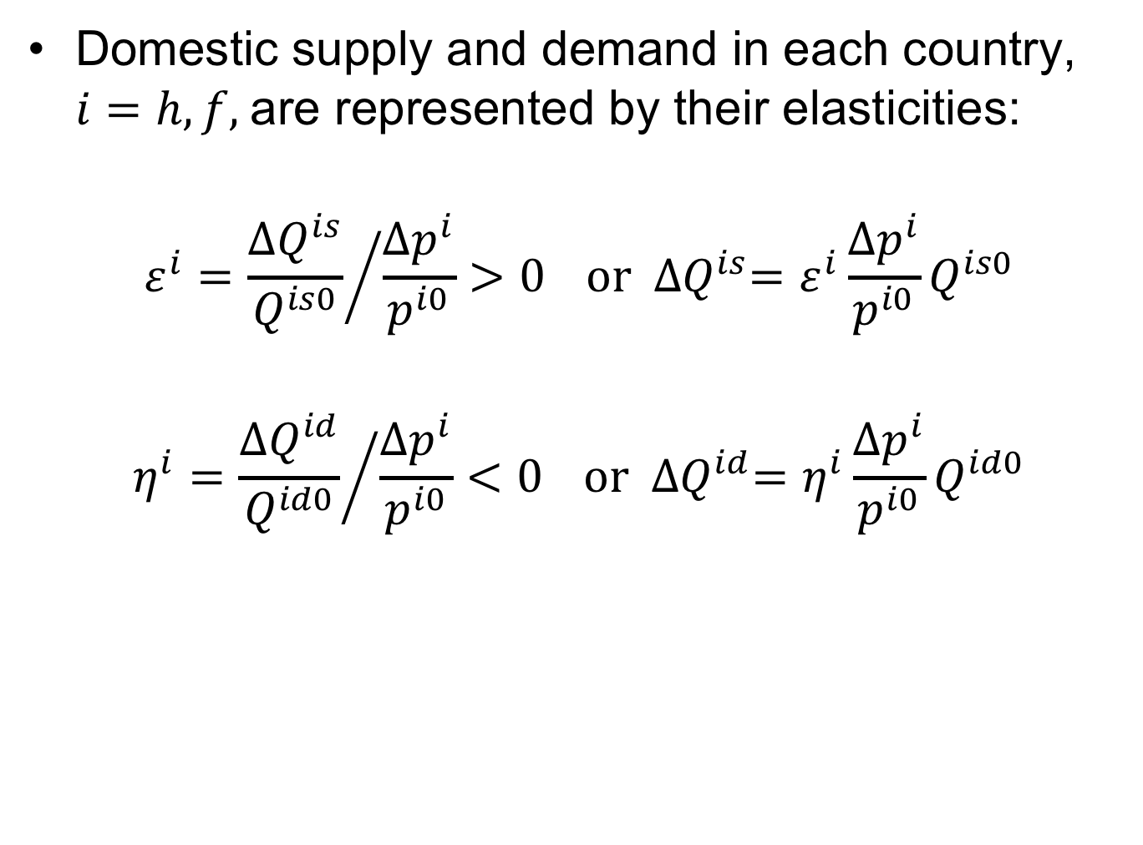
Two-Country in Equations
Domestic supply and demand in each country, $i=h, f,$are represented by their elasticities:
$$ε^{i}={\frac{{∆Q}^{is}}{Q^{is0}}}/{\frac{{∆p}^{i}}{p^{i0}}>0} or {∆Q}^{is}=ε^{i}\frac{{∆p}^{i}}{p^{i0}}Q^{is0}$$
$$η^{i}={\frac{{∆Q}^{id}}{Q^{id0}}}/{\frac{{∆p}^{i}}{p^{i0}}<0} or {∆Q}^{id}=η^{i}\frac{{∆p}^{i}}{p^{i0}}Q^{id0}$$

Slide 53
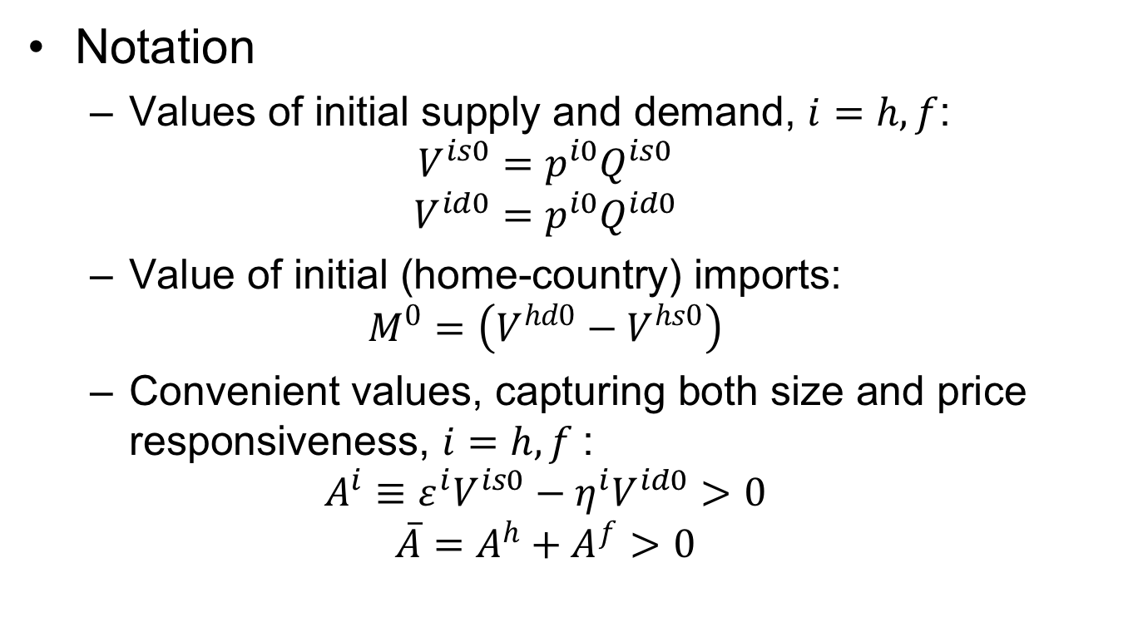
Two-Country in Equations
Notation
  Values of initial supply and demand, $i=h, f$:
  $$V^{is0}=p^{i0}Q^{is0}$$
  $$V^{id0}=p^{i0}Q^{id0}$$
  Value of initial (home-country) imports:
  $$M^{0}=\left(V^{hd0}−V^{hs0}\right)$$
  Convenient values, capturing both size and price responsiveness, $i=h, f$:
  $$A^{i}≡ε^{i}V^{is0}−η^{i}V^{id0}>0$$
  $${\overline{A}=A}^{h}+A^{f}>0$$

Slide 54
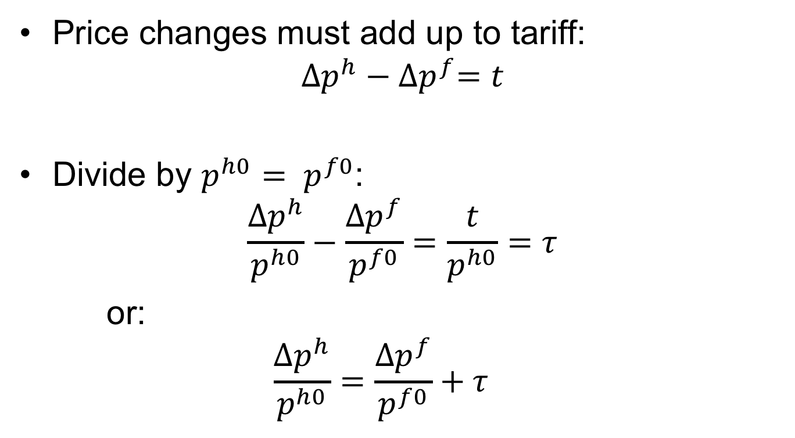
Two-Country in Equations
Price changes must add up to tariff:
$${∆p}^{h}−{∆p}^{f}=t$$
Divide by $p^{h0}= p^{f0}$:
$$\frac{{∆p}^{h}}{p^{h0}}−\frac{{∆p}^{f}}{p^{f0}}=\frac{t}{p^{h0}}=τ$$
or:
  $$\frac{{∆p}^{h}}{p^{h0}}=\frac{{∆p}^{f}}{p^{f0}}+τ$$

Slide 55

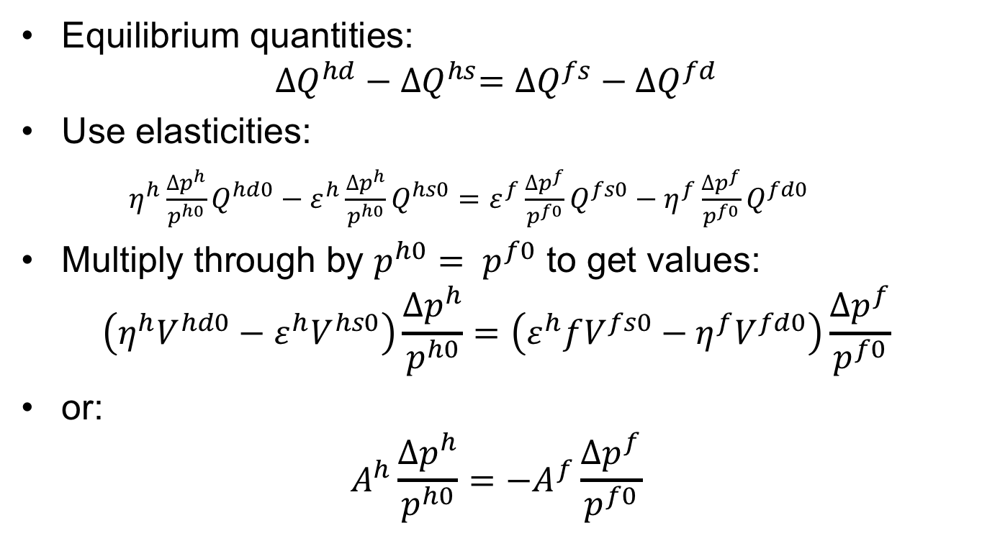
Two-Country in Equations
Equilibrium quantities:
$${∆Q}^{hd}−{∆Q}^{hs}={∆Q}^{fs}−{∆Q}^{fd}$$
Use elasticities:
$η^{h}\frac{{∆p}^{h}}{p^{h0}}Q^{hd0}−ε^{h}\frac{{∆p}^{h}}{p^{h0}}Q^{hs0}=ε^{f}\frac{{∆p}^{f}}{p^{f0}}Q^{fs0}−η^{f}\frac{{∆p}^{f}}{p^{f0}}Q^{fd0}$
Multiply through by $p^{h0}= p^{f0}$ to get values:
$$\left(η^{h}V^{hd0}−ε^{h}V^{hs0}\right)\frac{{∆p}^{h}}{p^{h0}}=\left(ε^{h}fV^{fs0}−η^{f}V^{fd0}\right)\frac{{∆p}^{f}}{p^{f0}}$$
or:
$$A^{h}\frac{{∆p}^{h}}{p^{h0}}={−A}^{f}\frac{{∆p}^{f}}{p^{f0}}$$
$$A^{h}$$

Slide 56
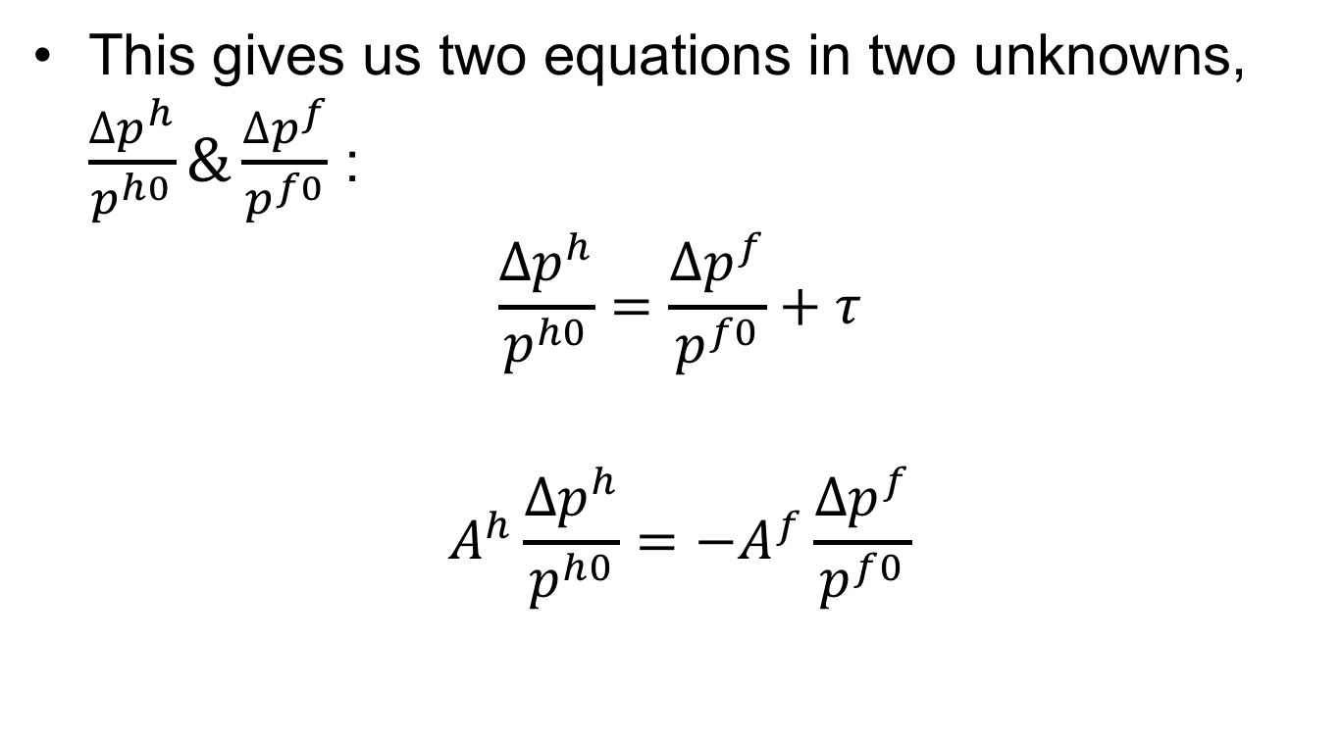
Two-Country in Equations
This gives us two equations in two unknowns, $\frac{{∆p}^{h}}{p^{h0}}\&\frac{{∆p}^{f}}{p^{f0}}$ :
$$\frac{{∆p}^{h}}{p^{h0}}=\frac{{∆p}^{f}}{p^{f0}}+τ$$
$$A^{h}\frac{{∆p}^{h}}{p^{h0}}={−A}^{f}\frac{{∆p}^{f}}{p^{f0}}$$

Slide 57
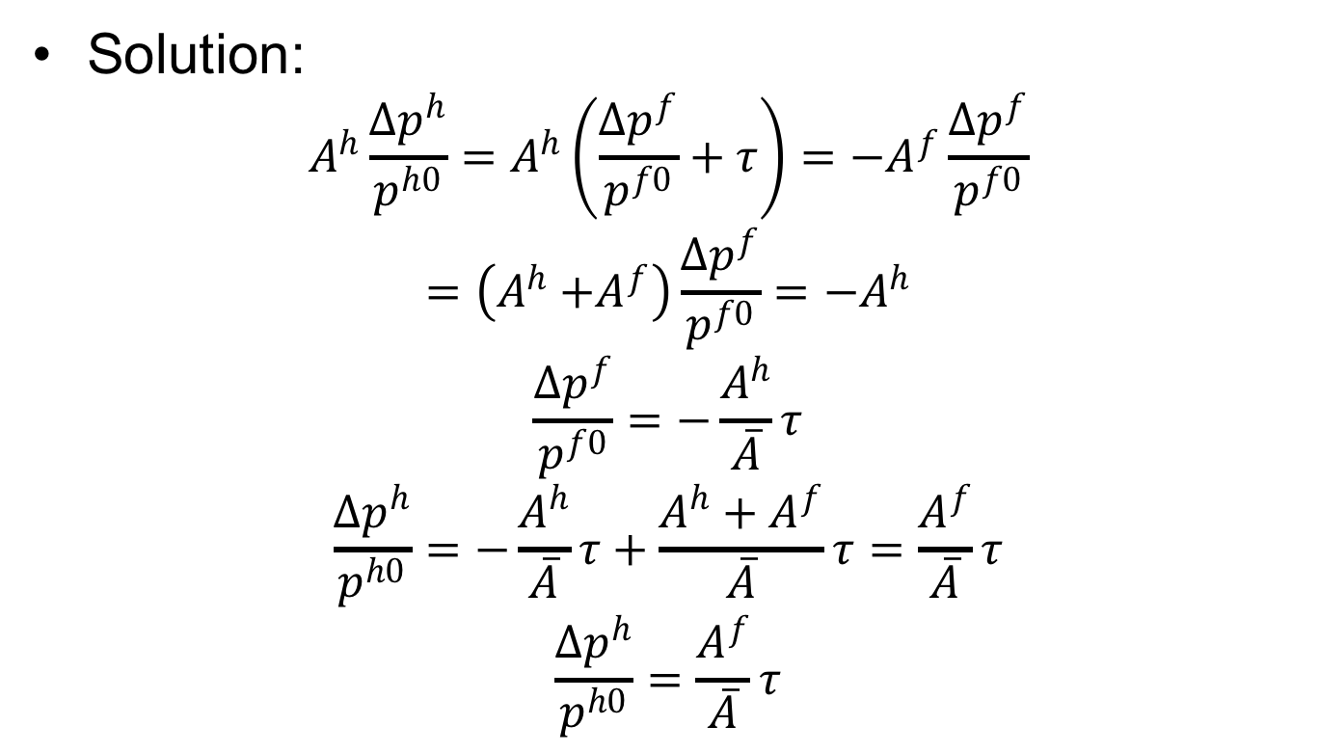
Two-Country in Equations
Solution:
$$A^{h}\frac{{∆p}^{h}}{p^{h0}}=A^{h}\left(\frac{{∆p}^{f}}{p^{f0}}+τ\right)={−A}^{f}\frac{{∆p}^{f}}{p^{f0}}$$
$$=\left(A^{h}{+A}^{f}\right)\frac{{∆p}^{f}}{p^{f0}}=−A^{h}$$
$$\frac{{∆p}^{f}}{p^{f0}}=−\frac{A^{h}}{\overline{A}}τ$$
$$\frac{{∆p}^{h}}{p^{h0}}=−\frac{A^{h}}{\overline{A}}τ+\frac{A^{h}+A^{f}}{\overline{A}}τ=\frac{A^{f}}{\overline{A}}τ$$
$$\frac{{∆p}^{h}}{p^{h0}}=\frac{A^{f}}{\overline{A}}τ$$

Slide 58
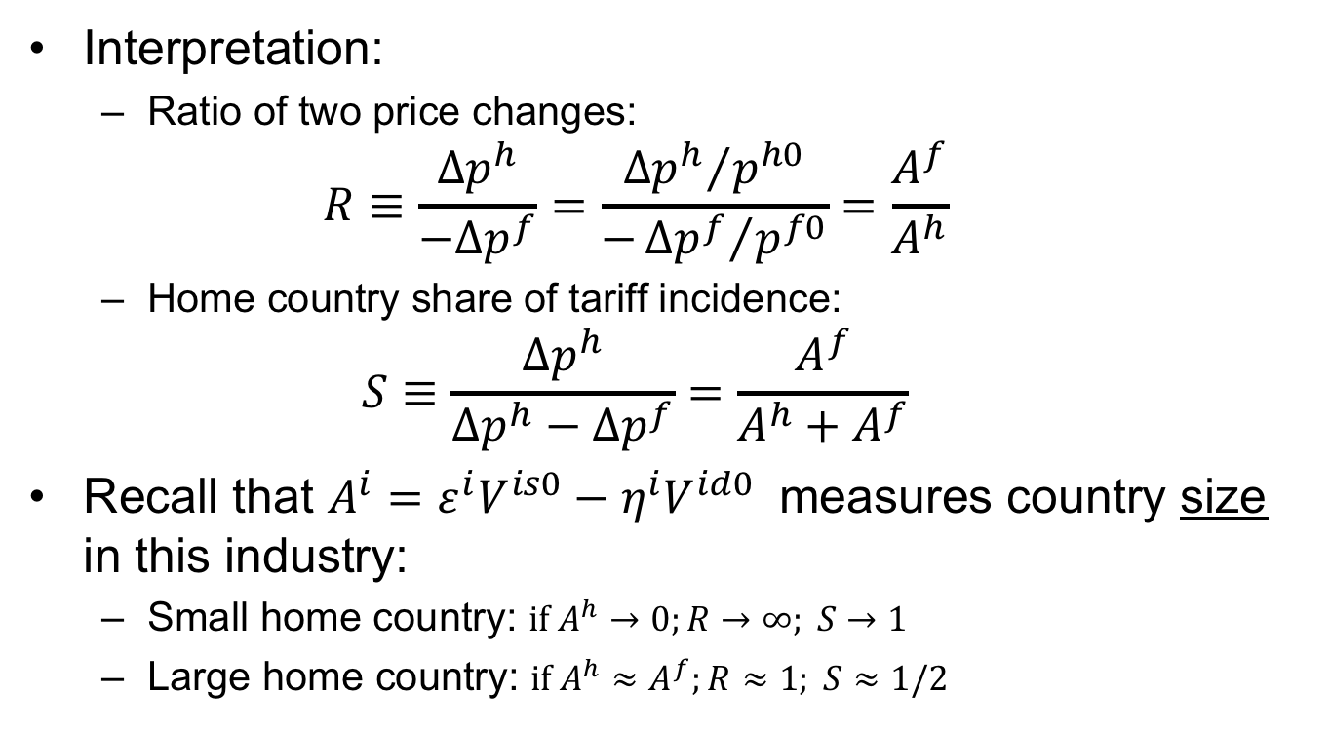
Two-Country in Equations
Interpretation:
  Ratio of two price changes:
  $$R≡\frac{{∆p}^{h}}{−{∆p}^{f}}=\frac{{{∆p}^{h}}/{p^{h0}}}{−{{∆p}^{f}}/{p^{f0}}}=\frac{A^{f}}{A^{h}}$$
  Home country share of tariff incidence:
  $$S≡\frac{{∆p}^{h}}{{∆p}^{h}−{∆p}^{f}}=\frac{A^{f}}{A^{h}+A^{f}}$$
Recall that $A^{i}=ε^{i}V^{is0}−η^{i}V^{id0}$ measures country size in this industry:
  Small home country: $if A^{h}→0;R→∞; S→1$
  Large home country: ${if A}^{h}≈A^{f};R≈1; S≈1/2$

Slide 59
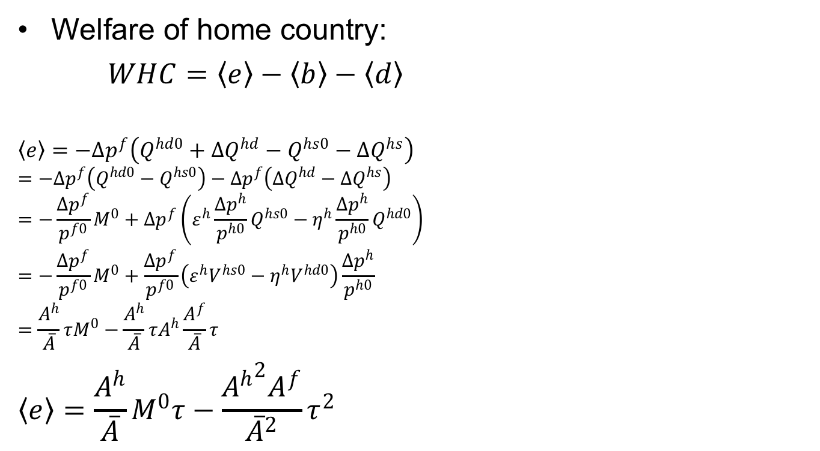
Two-Country in Equations
Home
P^{h}
S^{h}
Welfare of home country:
$WHC=〈e〉−〈b〉−〈d〉$
$$〈e〉=−{∆p}^{f}\left(Q^{hd0}+{∆Q}^{hd}−Q^{hs0}−{∆Q}^{hs}\right)$$
$$=−{∆p}^{f}\left(Q^{hd0}−Q^{hs0}\right)−{∆p}^{f}\left({∆Q}^{hd}−{∆Q}^{hs}\right)$$
$$=−\frac{{∆p}^{f}}{p^{f0}}M^{0}+{∆p}^{f}\left(ε^{h}\frac{{∆p}^{h}}{p^{h0}}Q^{hs0}−η^{h}\frac{{∆p}^{h}}{p^{h0}}Q^{hd0}\right)$$
$$=−\frac{{∆p}^{f}}{p^{f0}}M^{0}+\frac{{∆p}^{f}}{p^{f0}}\left(ε^{h}V^{hs0}−η^{h}V^{hd0}\right)\frac{{∆p}^{h}}{p^{h0}}$$
$$=\frac{A^{h}}{\overline{A}}τM^{0}−\frac{A^{h}}{\overline{A}}τA^{h}\frac{A^{f}}{\overline{A}}τ$$
$$〈e〉=\frac{A^{h}}{\overline{A}}M^{0}τ−\frac{{A^{h}}^{2}A^{f}}{{\overline{A}}^{2}}τ^{2}$$
P^{h1}
t
a
c
b
d
P^{h0}=P^{f0}
e
P^{f1}
Q^{hs0}
Q^{hd0}

Slide 60

Two-Country in Equations
Home
P^{h}
S^{h}
Welfare of home country:
$WHC=〈e〉−〈b〉−〈d〉$
$$〈b〉+〈d〉={∆p}^{h}\left({∆Q}^{hs}−{∆Q}^{hd}\right)/2$$
$$=\frac{{∆p}^{h}}{2p^{h0}}\left(ε^{h}\frac{{∆p}^{h}}{p^{h0}}{p^{h0}Q}^{hs0}−η^{h}\frac{{∆p}^{h}}{p^{h0}}{p^{h0}Q}^{hd0}\right)$$
$$=\frac{{∆p}^{h}}{2p^{h0}}\left(ε^{h}V^{hs0}−η^{h}V^{hd0}\right)\frac{{∆p}^{h}}{p^{h0}}$$
$=\frac{1}{2}A^{h}{\left(\frac{{∆p}^{h}}{p^{h0}}\right)}^{2}$ $=\frac{1}{2}A^{h}{\left(\frac{A^{f}}{\overline{A}}τ\right)}^{2}$
$$〈b〉+〈d〉=\frac{{{A^{h}A}^{f}}^{2}}{{2\overline{A}}^{2}}τ^{2}$$
P^{h1}
t
a
c
b
d
P^{h0}=P^{f0}
e
P^{f1}
Q^{hs0}
Q^{hd0}

Slide 61


Welfare of Home Country
$WHC=〈e〉−\left(〈b〉+〈d〉\right)=\left[\frac{A^{h}}{\overline{A}}M^{0}τ−\frac{{A^{h}}^{2}A^{f}}{{\overline{A}}^{2}}τ^{2}\right]−\frac{{{A^{h}A}^{f}}^{2}}{{2\overline{A}}^{2}}τ^{2}$
Welfare
P
P_{aut}
b
XS*
c
P₁
a
b
t
c
d
$τ$_{opt}
$τ$
P*₁
MD
c–b
P_{aut}*
M₁=X*₁
M₀=X*₀
M,X*
P_{aut}–P_{aut}*

Slide 62
Two-Country in Equations
Other effects can be calculated similarly from the areas in the figure:
Home
World
Foreign
P^{h}
P
P^{f}
S^{h}
XS*
S^{f}
P^{h1}
D^{f}
P^{h1}
t
a
c
t
c
b
d
f
P^{h0}=P^{f0}
e
g
i
j
e
h
e
P^{f1}
P^{f1}
P^{f1}
D^{h}
MD
Q^{hs0}
Q^{hd0}
Q^{h}
M₀=X*₀
M,X*
Q^{fs0}
Q^{fd0}
Q^{f}

Slide 63
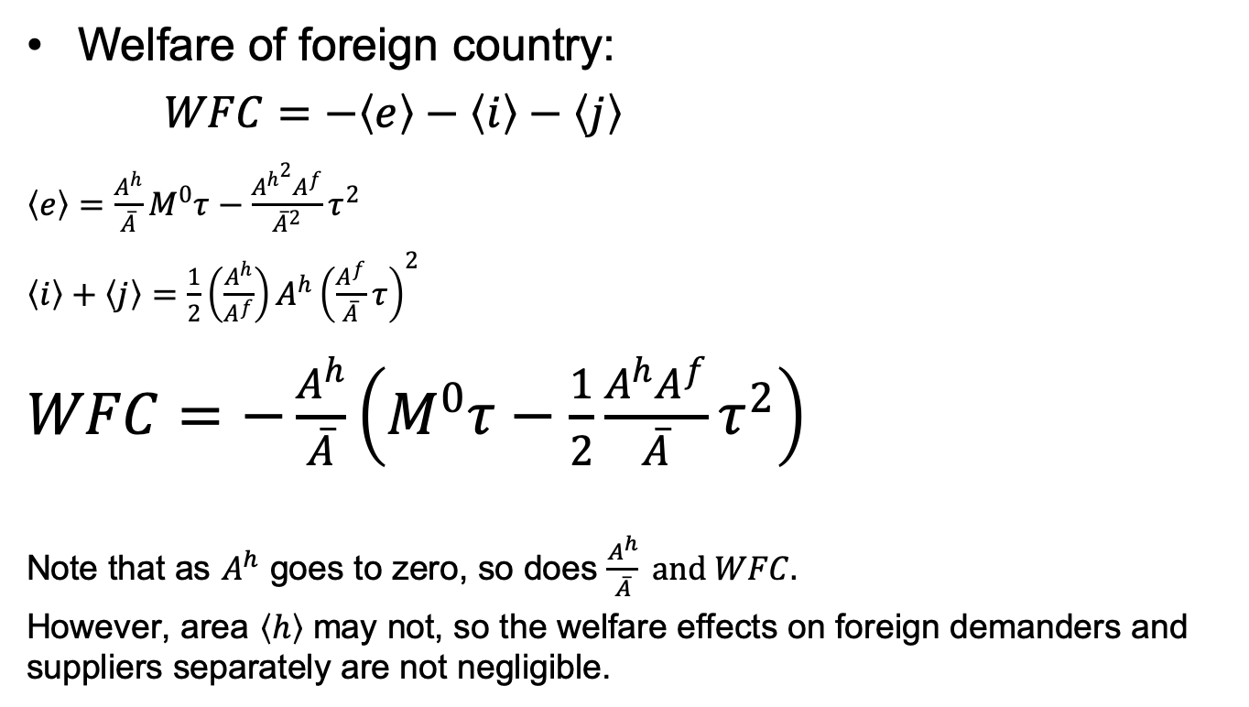
Two-Country in Equations
Foreign
P^{f}
Welfare of foreign country:
$WFC=−〈e〉−〈i〉−〈j〉$
$〈e〉=\frac{A^{h}}{\overline{A}}M^{0}τ−\frac{{A^{h}}^{2}A^{f}}{{\overline{A}}^{2}}τ^{2}$
$〈i〉+〈j〉=\frac{1}{2}\left(\frac{A^{h}}{A^{f}}\right)A^{h}{\left(\frac{A^{f}}{\overline{A}}τ\right)}^{2}$
$WFC=−\frac{A^{h}}{\overline{A}}\left(M^{0}τ−\frac{1}{2}\frac{A^{h}A^{f}}{\overline{A}}τ^{2}\right)$
Note that as $A^{h}$ goes to zero, so does $\frac{A^{h}}{\overline{A}} and WFC.$
However, area $〈h〉$ may not, so the welfare effects on foreign demanders and suppliers separately are not negligible.
S^{f}
D^{f}
P^{h0}=P^{f0}
i
j
h
e
P^{f1}
Q^{fs0}
Q^{fd0}
Q^{f}

Slide 64
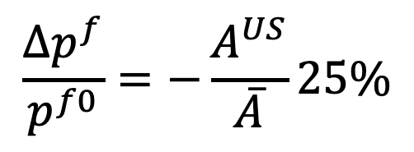


Is the US a Large Country?
Consider Trump’s 25% tariff on steel
So
  Foreign price of steel should fall by 25% time the US share of the world market
  US price of steel should rise by 25% of the foreign share of the world market
$$\frac{{∆p}^{f}}{p^{f0}}=−\frac{A^{US}}{\overline{A}}25\%$$
$$A^{US}≡ε^{US}V^{USs0}−η^{US}V^{USd0}$$
$${\overline{A}=A}^{US}+A^{f}$$

Slide 65
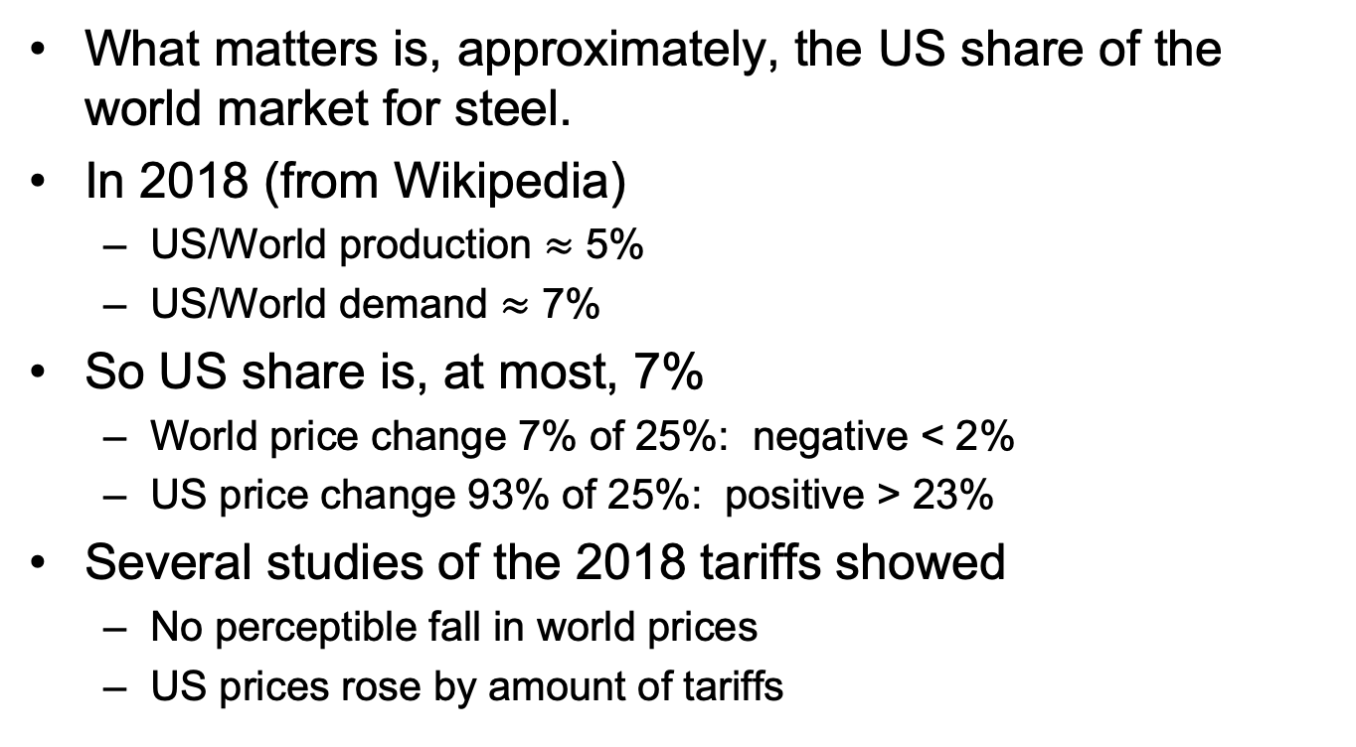
Is the US a Large Country?
What matters is, approximately, the US share of the world market for steel.
In 2018 (from Wikipedia)
  US/World production $≈$ 5%
  US/World demand $≈$ 7%
So US share is, at most, 7%
  World price change 7% of 25%: negative < 2%
  US price change 93% of 25%: positive > 23%
Several studies of the 2018 tariffs showed
  No perceptible fall in world prices
  US prices rose by amount of tariffs

Slide 66
Pause for Questions

Slide 67
Quotas
Quota puts upper limit on quantity of imports
Analysis is exactly the same as a tariff, except
  Policy sets quantity of imports
  Price difference determined by market
  Price difference is “tariff equivalent” of the quota
Welfare analysis of quota is the same as tariff, except
  “Quota rent” instead of tariff revenue
Who gets the quota rent?
  Depends on how quota is administered
  Most commonly, goes to foreigners

Slide 68
Small country quota
(with rents to foreigners)
P
Welfare effects of a quota,q, starting from free trade
  Suppliers gain +a
  Demanders Lose −(a+b+c+d)
  Government gains nothing
  Country loses −(b+c+d)
S
P_{aut}
P₁=P_{W}+t^{eq}
t^{eq}
a
c
b
d
P₀=P_{W}
Foreign gains quota rent +c
  But this is negligible for world, since country is small
D
q =M₁
S₀
S₁
D₁
D₀
Q
M₀
World dead-weight loss is still b+d
Quota q

Slide 69
Large country quota
(with rents to foreigners)
Welfare effects of a large-country quota, starting from free trade
Home:
  Private sector (S&D) loses −(a+b)
  Government gains 0
  Country must lose: −(a+b)
Foreign:
  Private sector (S&D) loses −(c+d)
  Foreigners gain rents +(a+c)
  Country may gain or lose +a−d
World loses −(b+d)
World Market
Home is Importer
Foreign (*) is Exporter
P
XS*
P₁
a
b
t^{eq}
c
d
P*₁
MD
Q=M₁=X*₁
M₀=X*₀
M,X*
“Dead Weight Loss” =

Slide 70
Pause for Discussion

Slide 71
  Questions on Quotas
How might quotas be administered; what happens to the quota rents in each case?
How is an import quota equivalent to a tariff? How is it not?
With a fixed and binding import quota, how will the domestic price and the tariff-equivalent of the quota change if curves shift?

Slide 72
Recent Tariff Threats
Oil
  Oil price dropped 60% with pandemic
    Demand fell with reduced travel and production
    Oil producers were in price war
  Trump floated the idea of a tariff on imported oil
    Purpose to help US oil producers

Slide 73
Recent Tariff Threats
Wine
  US put 25% tariff on European wine, as part of Boeing-Airbus retaliation
  In February, Trump threatened to raise the tariff to 100%
    [Later report said this was postponed to at least 2021

Slide 74
Recent Tariff Threats
Champagne
  In response to France’s digital services tax, the US is threatening 100% tariffs on $2.4 billion of French wine and luxury goods
  This would include champagne.
  Who would pay the tariffs?
    Article (Toplensky) suggests US consumers would pay
    How does that fit with what we learned today?

Slide 75
Pause for Discussion

Slide 76
  Questions on Tariff Threats
What is OPEC+?
Who is protesting against raising the tariff on wine to 100%?
What does it mean for wine to be “on the water,” and why is that relevant?
Might the tariff on champagne be avoided by negotiation?

